Slide 1


Slide 2
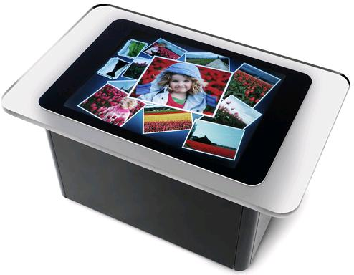

Slide 3
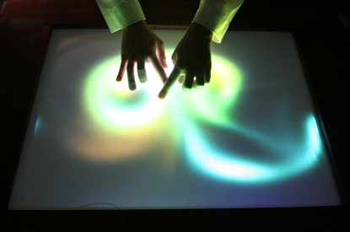

Slide 4

MULTITOUCH POLYGON MORPHING

Slide 5
